Slide 1
Module 4 Dynamic Programming
Introduction to Dynamic Algorithms
All pair shortest path
0/1 knapsack
Travelling salesman problem
Matrix Chain Multiplication
Optimal binary search tree
Analysis of All algorithms and problem solving

Slide 2
Difference between Greedy and Dynamic Programming Method
Greedy method: predefined procedure to get optimal solution
Dynamic Programming: find all possible solutions and then find optimal solution.
DP problems are solved using recursive formula. Mostly solved using iterations.
DP follows principle of optimality which says that a problem can be solved by taking a sequence of decisions to get optimal solution.
In Greedy method decision is taken only once. In DP , at every stage we take decision.
DP adopts tabular and memoization methods.

Slide 3
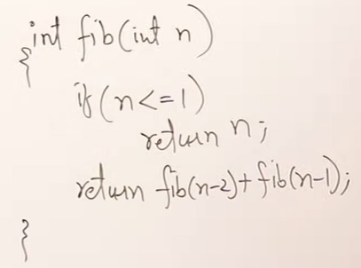
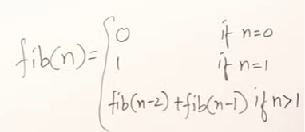
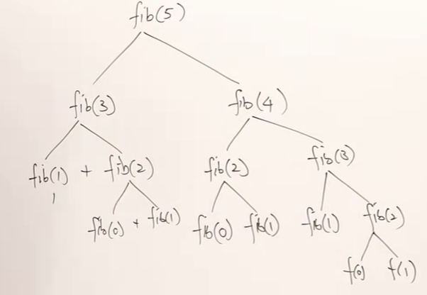
RR:
T(n)=2T(n-1) + 1 , assuming n-2=n-1
TC = O(2^{n})
Can we reduce this TC?
[2^(n-1) -1 ]Calls

Slide 4
Memoization Method
Write the recursive code
Memoize the return value and use it to reduce recursive calls.
RR:
T(n)=2T(n-1) + 1 , assuming n-2=n-1
TC = O(2^{n}) .. Using Master’s Theorem.
Can we reduce this TC?
Only 6(n+1) calls . —> O(n)
Time reduced from Exponential to linear polynomial.
F
-1 | -1 | -1 | -1 | -1 | -1
Memoization is a Top-Down approach
0 1 2 3 4 5
F
0 | 1 | 1 | 2 | 3 | 5
0 1 2 3 4 5

Slide 5
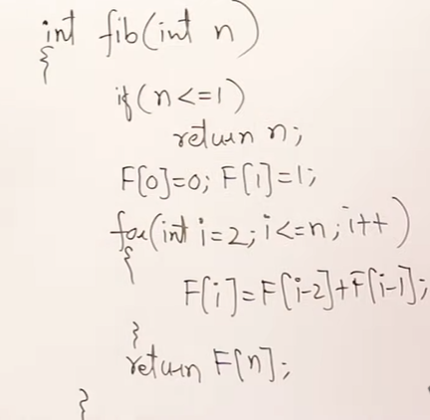
Tabulation/Iterative Method (using recursive formula)
Bottom Up approach as table is filled from smaller value first.
F
0 | 1 | 1 | 2 | 3 | 5
0 1 2 3 4 5

Slide 6
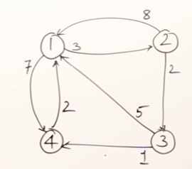
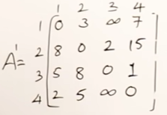
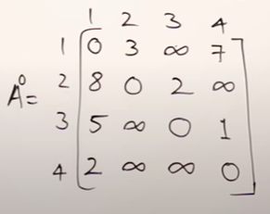
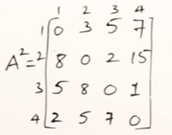
All Pairs Shortest Path (Floyd-Warshall) - Dynamic Programming method
1 as intermediate vertex
1 as intermediate vertex
2 as intermediate vertex

Slide 7
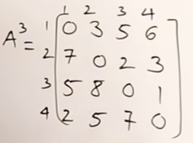
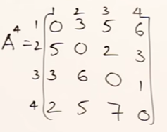
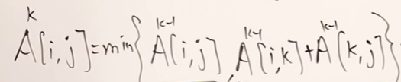
All Pairs Shortest Path (Floyd-Warshall) - Dynamic Programming
Recursive Formula:

Slide 8
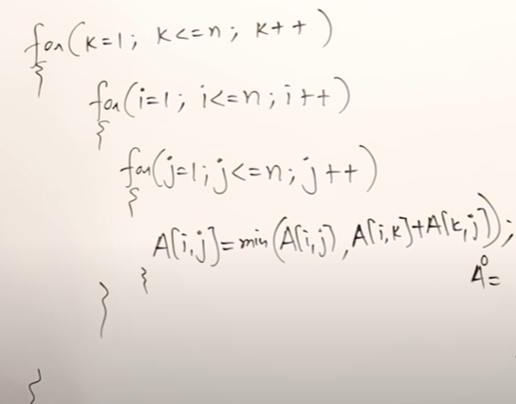
Time Complexity
All Pairs Shortest Path (Floyd-Warshall) - Dynamic Programming
Formula:
TC=O(n³)

Slide 9
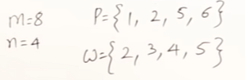
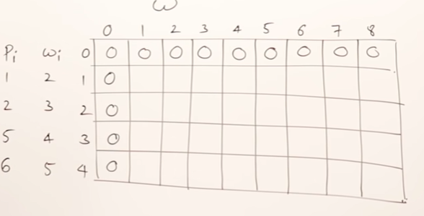
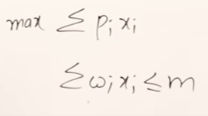
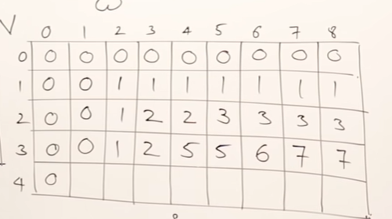
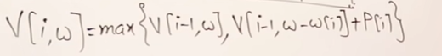
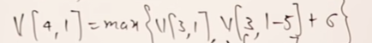
0/1 Knapsack Problem(Tabular Method)

Slide 10
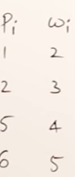
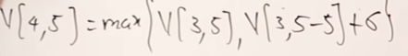
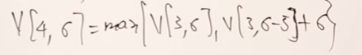
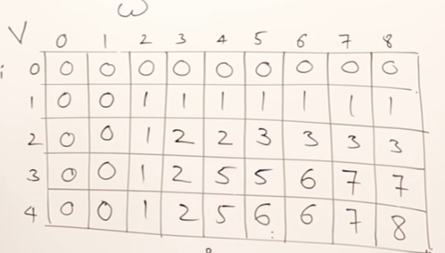
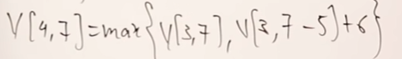
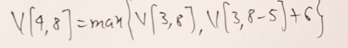
0/1 Knapsack Problem

Slide 11
How to find solution once table is created?

Slide 12
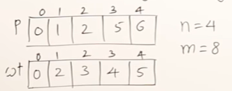
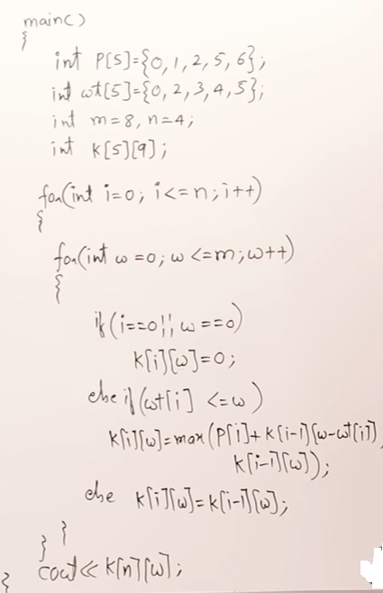
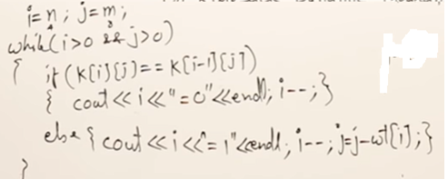
0/1 Knapsack Problem : Program and TC
TC= O(n.m)

Slide 13
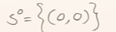
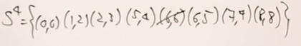
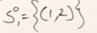

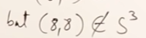
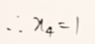
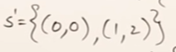
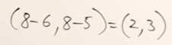
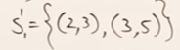
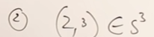
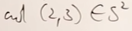
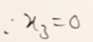
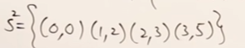
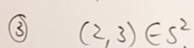
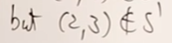
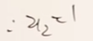
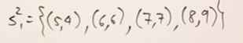
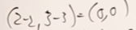
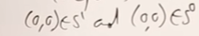
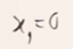
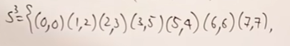
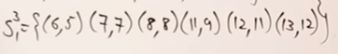
0/1 Knapsack Problem (Set Method)
Solution = (0,1,0,1)

Slide 14
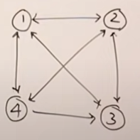
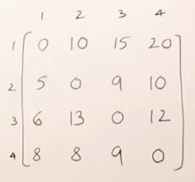


Travelling Salesman Problem: DP approach
TSP: Start from source vertex, visit all vertices once and return back to source vertex. Travel such that total cost of travelling is minimum.
General Formula:
Formula wr.t no. of vertices=4:

Slide 15

Recursion Tree

Slide 16





Slide 17




Slide 18


Slide 20




Set 1:Nothing remaining
Set 2:one vertex remaining
Set 3:Two vertices remaining
Set 4:Three vertices remaining

Slide 21


Set 1:Nothing remaining
Set 2:one vertex remaining
Set 3:Two vertices remaining
Set 4:Three vertices remaining
How to find Minimum cost path using above table: Source vertex =1
From set 4, we got minimum cost = with k=2. So salesman will visit city 2 first from source source city 1. So now salesman at vertex 2 with remaining cities to be visited as 3 and 4.
Now look at set3. Here we got for k=4 . So salesman will visit city 4 from current city 2. So now salesman at city 4 with remaining cities to be visited as 3
Now look at set2. Here we got for k=3. So salesman will visit vertex 3 from current city 4. So now salesman at vertex 3 with no remaining cities to be visited. So he will return back to source city 1.
Thus the sequence in which salesman will travel from source city 1 is 1-2-4-3-1 with the cost of 35 🡺 optimal sequence.

Slide 22

Set 1:Nothing remaining
Set 2:one vertex remaining
Set 3:Two vertices remaining
Set 4:Three vertices remaining
How to find Minimum cost path using above table: Source vertex =1
Greedy solution? 1—2---3—4—1 cost=39

Slide 23
TSP Time Complexity https://www.youtube.com/watch?v=vq_vEBlEmZY
Time complexity= O(n²2^{n})

Slide 24



Matrix Chain Multiplication
A1 x A2 x A3
Total no. of multiplications=24+16=40
Total no. of multiplications=24+12=36
For multiplying n matrices , find the best paranthesization which will minimize the total efforts required.

Slide 25








Formula:
C[1,3]=Cost of multiplying A1x A2xA3

Slide 26

Matrix Chain Multiplication
A1 x A2 x A3 x A4
No. of possible parenthesizing:
A₁ x A₂ x A₃ x A₄ x ……..x A_{n}
No. of possible parenthesizing =
^{2n’}C_{n’}/(n’+1) where n’=n-1

Slide 27


A₁ x A₂ x A₃ x A₄
Create a table of values and fill smaller values first , then larger ones.

Slide 28



Table creation:
Example:
A₁ x A₂ x A₃ x A₄
3 2 2 4 4 2 2 5
d0 d1 d2 d3 d4
K-values Table: store value of k that gives minimum cost
C Table(Cost table)
C[I,j]=0 , for i=j

Slide 29


C[1,4] = 58
The best paranthesization for given example will give you 58 number of multiplications.

Slide 30
How to find best parenthesization from tables? Use k-values table
C[1,4] = 58
The best paranthesization for given example will give you 58 number of multiplications.
Start with k[1,4] = 3 . So parenthesize A1 to A3. (A1 x A2 x A3) x (A4)
K[1,3] = 1 , So parenthesize A1. ((A1) x (A2 x A3)) x (A4)
K[2,3]=2. So parenthesize A2, . ((A1) x ((A2) x (A3))) x (A4)
Time taken to fill the table(4 matrices) = 1+2+3+4= 4(4+1)/2
For n matrices time taken to fill table= 1+2+3+…..+n= n(n+1)/2=O(n²)
Each matrix is computed by taking different k values(from i to j).
Let k=n (UB for k value).
Then TC = O(n³) =UB

Slide 31

Program

Slide 32


Optimal Binary search Tree
Cost of searching in a BST= No. of comparisons required to find the key starting from root node.
Consider BST shown below.
The no. of possible BSTs for a given set of n keys =

Slide 33


Optimal Binary search Tree
Successful and unsuccessful search probability : n=4, so 14 different BSTs possible.
Consider one of these 14 BSTs as below.
Square nodes represents unsuccessful search . If no. of keys is n , no. of square nodes in a BST=n+1

Slide 34

Optimal Binary search Tree
How to find cost of searching based on successful and unsuccessful probabilities?
Square nodes represents unsuccessful search . If no. of keys is n , no. of square nodes in a BST=n+1
Cost of searching 20 = ( no. of comparisons x prob of successful search)=1 x 0.2
Cost of searching 40 = ( no. of comparisons x prob of successful search)=3 x 0.1
Cost of searching 9 = ( no. of comparisons x prob of unsuccessful search)=2 x 0.1
Cost of searching 42 = ( no. of comparisons x prob of unsuccessful search)=3 x 0.05
Total Cost of searching = ( 1 x 0.2 + 2 x 0.1 + 2 x 0.1 + 3 x 0.2 ) + (2 x 0.1 + 2 x 0.05 + 2 x 0.15 + 3 x 0.05 + 3 x 0.05) =2.1
Formula:

Slide 35
Optimal Binary search Tree Problem
If the keys and the successful and unsuccessful probabilities are given, then generate a BST such that total cost of searching is minimized.
How to construct OBST ??

Slide 36



Dynamic Programming approach to find optimal BST
Here to find C[0,3], I need to know C[1,3], C[2,3], C[0,2] etc…
i.e For finding higher values, I need to know lower values.
To find C[0.3], I need all following values

Slide 37



Apart from finding the cost, we should also know which k gives a minimum cost. From that we will select it as a root.
What is w[i,j] ???`
w[I,j]= q_{i} for i=j
For j > i, w is calculated as below:

Slide 38



Example:
Minimum cost of searching is C[0,4]= 32 /16 = 2

Slide 39




How to draw OBST from table?
Minimum cost of searching is C[0,4].So, R[0,4]=2 i,.e second key 20 is root of OBST. k-=2

